Slide 1
CS 341 Lab 2
Fall 2020

Slide 2
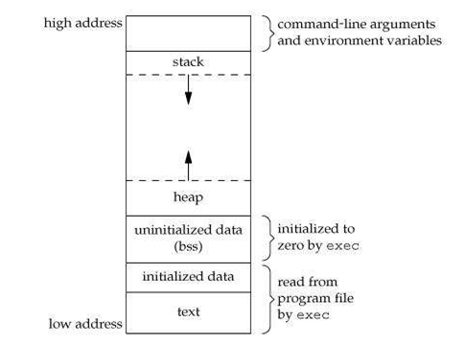
Von Neumann architecture
All memory in one index-able space
Text stores compiled instructions
Data section stores global variables
Stack stores local variables and function arguments
Heap stores dynamically allocated variables (malloc)
More widely used
https://www.hackerearth.com/practice/notes/memory-layout-of-c-program/

Slide 3
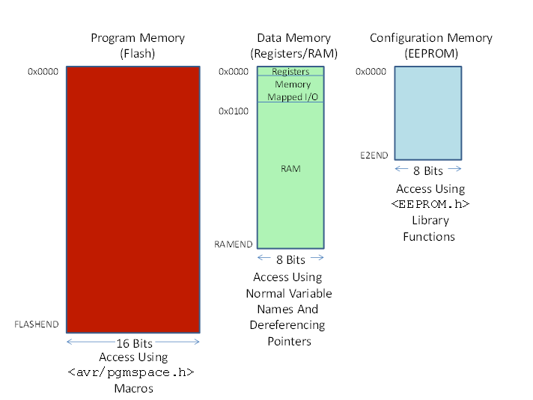
Harvard architecture
Memory in three index-able spaces
Program – compiled code
Data – variables
Configuration – settings, long term storage
used by Arduino

Slide 4
Part 1
Find out how large our memory spaces are
FLASHEND, RAMEND, E2END

Slide 5
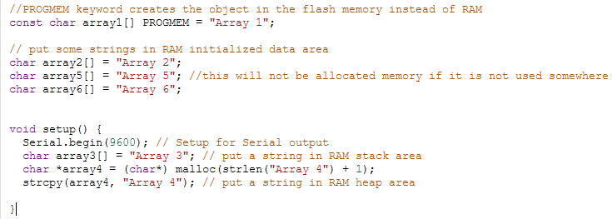
Parts 2 & 3
The heap, stack, and initialized data are all stored between 0x100 and RAMEND
How is it divided up?
Some arrays have already been created to help you:

Slide 6
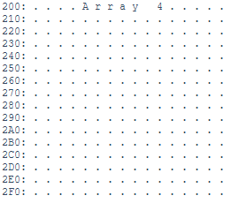
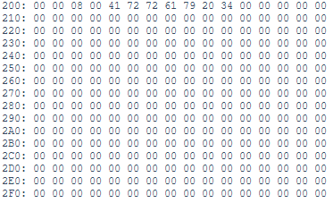
Example Output
Ran with hex set to false
The string “Array 4” is found at memory address 0x20A
Ran with hex set to true

